Slide 1
Discussion 5 Relational Algebra, Sorting and Hashing
Xie chenghuan

Slide 2
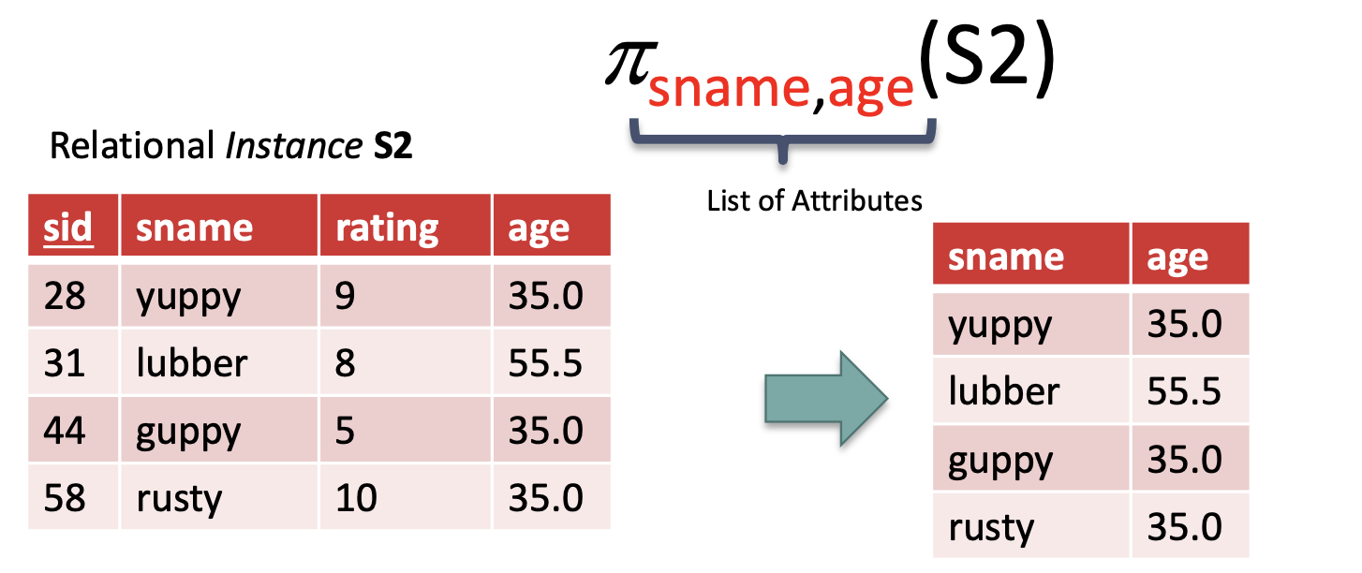
Relational Algebra关系代数
Projection (π ): Retains only desired columns (vertical) 取列操作

Slide 3
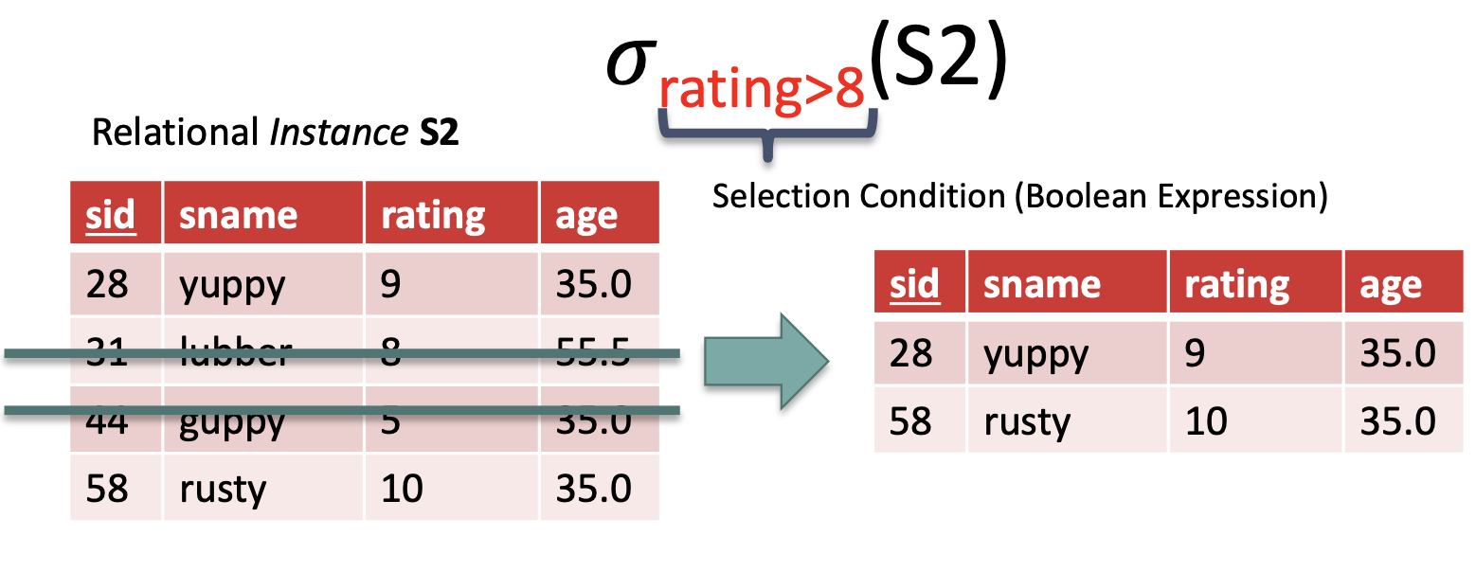
Relational Algebra关系代数
Selection (σ ): Selects a subset of rows (horizontal) 取行操作

Slide 4
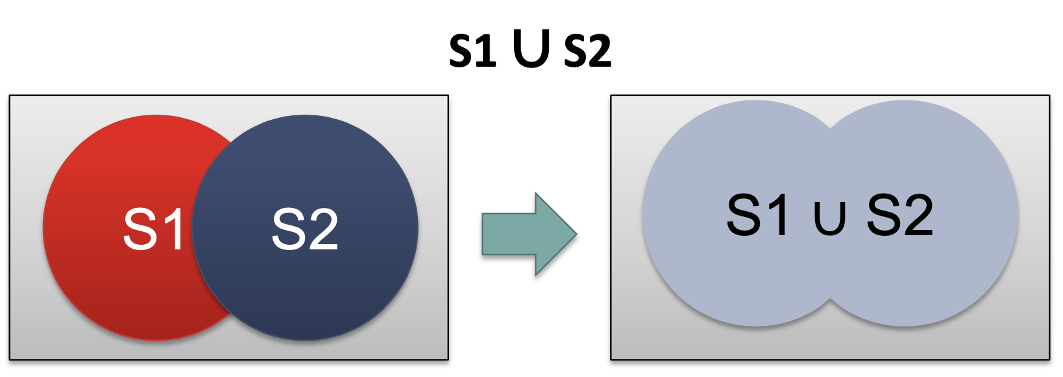
Relational Algebra关系代数
Union (∪): Tuples in r1 or in r2 取并集

Slide 5
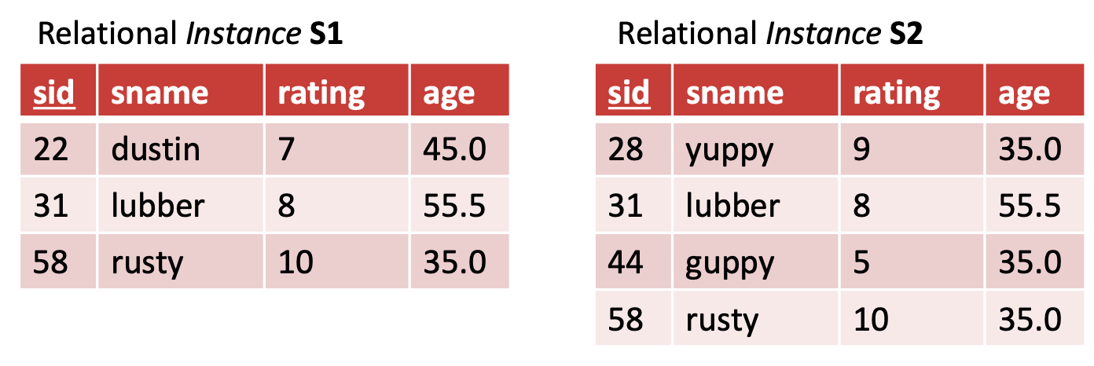
Relational Algebra关系代数
Union (∪) 去重 S1∪S2= 22，31，58，28，44 所在行
Union ALL 不去重 S1∪S2= 22，31，58，28，31，44，58 所在行
也就是说，31和58所在行出现了两次

Slide 6
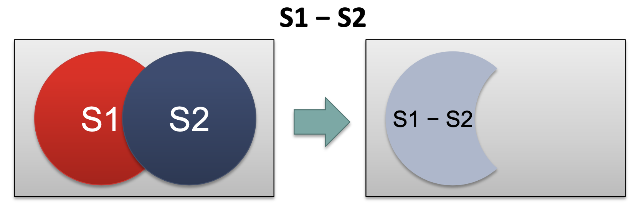
Relational Algebra关系代数
Set-difference ( — ): Tuples in r1, but not in r2. 取差集

Slide 7
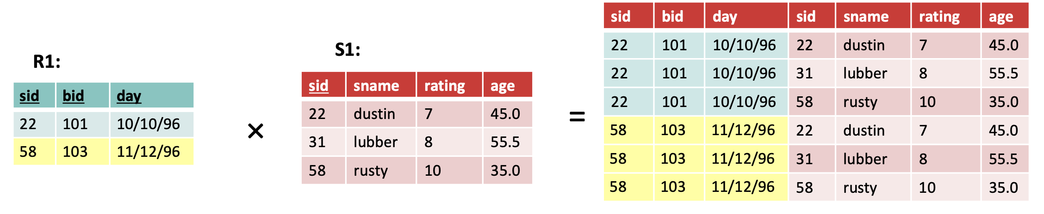
Relational Algebra关系代数
Cross-product ( × ): Allows us to combine two relations 向量积
行相乘，列相加
R1:2*3 S1:3*4 R1xS1:6*7=(2*3)*(3+4)

Slide 8
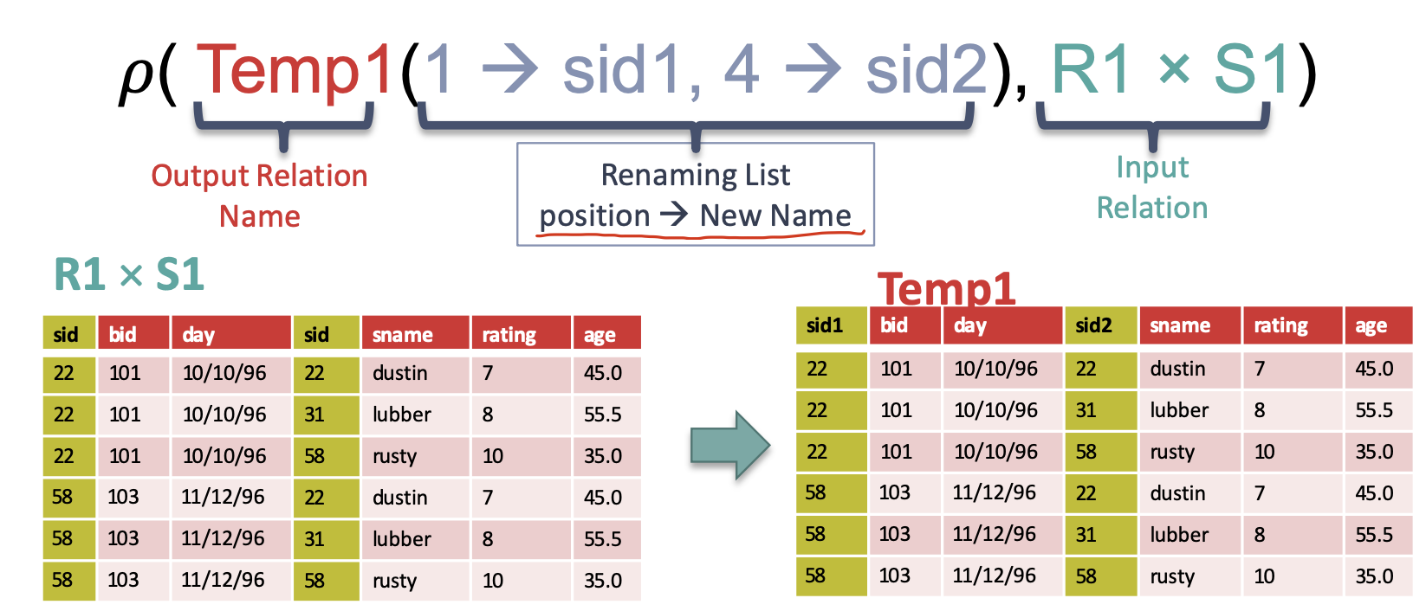
Relational Algebra关系代数
Renaming ( 𝜌 ): Rename attributes and relations 重命名

Slide 9
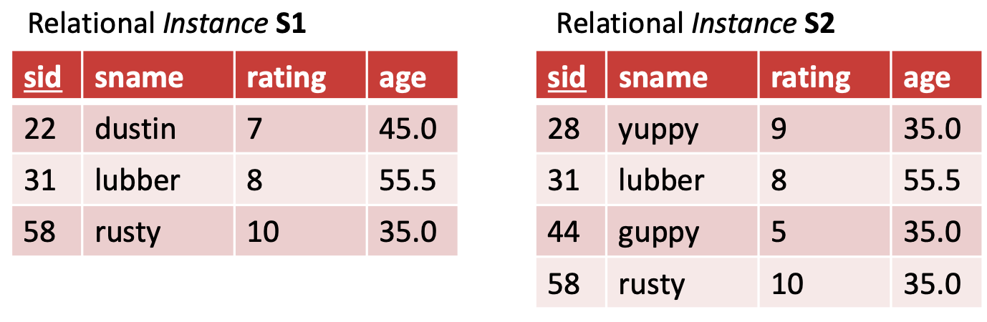
Relational Algebra关系代数
Intersection ( ∩ ): Tuples in r1 and in r2 取交集
S1 ∩ S2 = S1 — (S1 — S2) = 31，58所在行

Slide 10
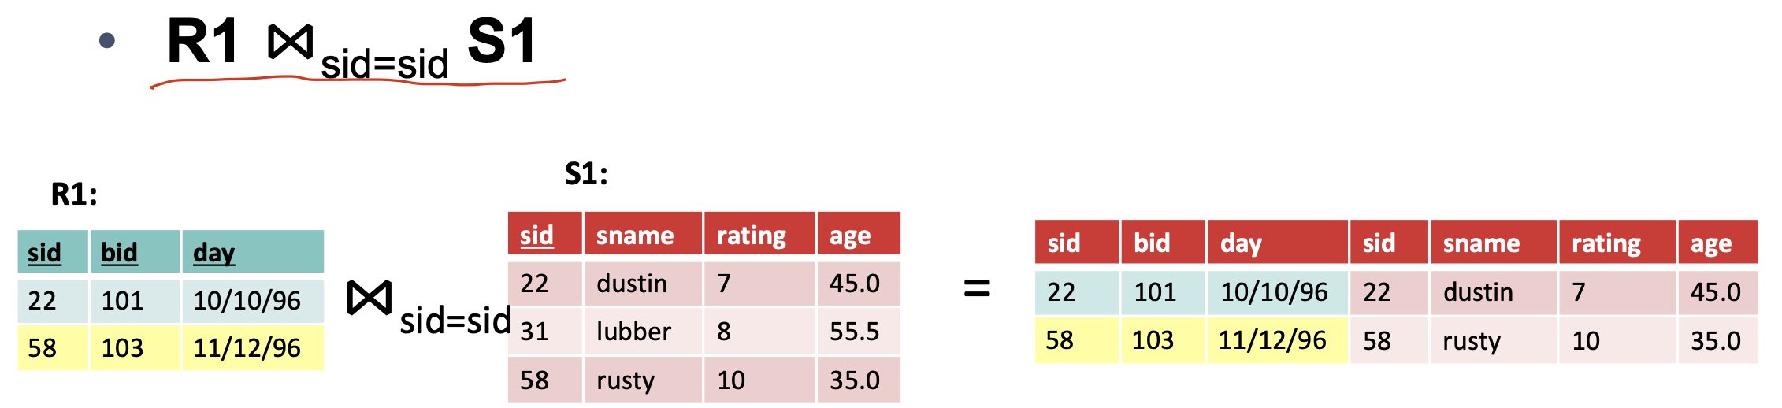
Relational Algebra关系代数
Theta Join ( ⋈_{𝜃} ): join on logical expression 𝜃
（在Cross-product ( × )基础上）行满足𝜃条件（R1的sid=S1的sid）

Slide 11
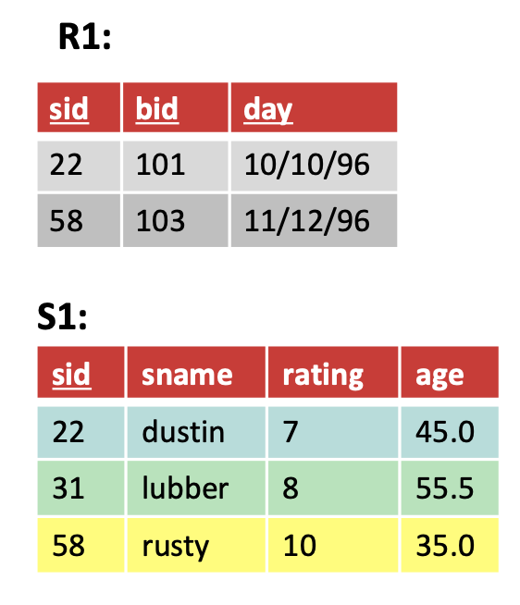
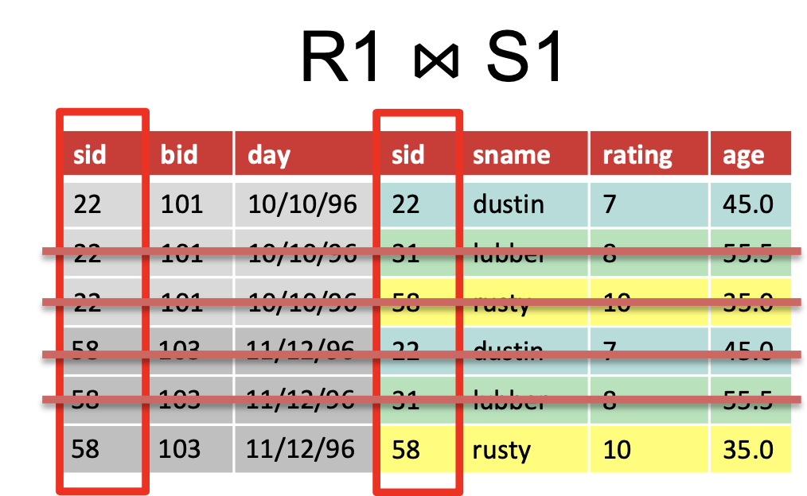
Relational Algebra关系代数
Natural Join(⋈): equi-join on all matching column names
（在Cross-product ( × )基础上），R1和S1中名字相同的列值必须相同

Slide 12
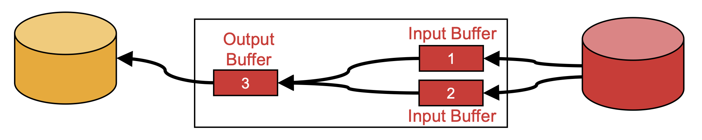
Two-Way External Merge Sort
requires 3 buffer pages
Pass 0: read a page, sort it, write it 针对每个page里面的元素排序

Slide 13
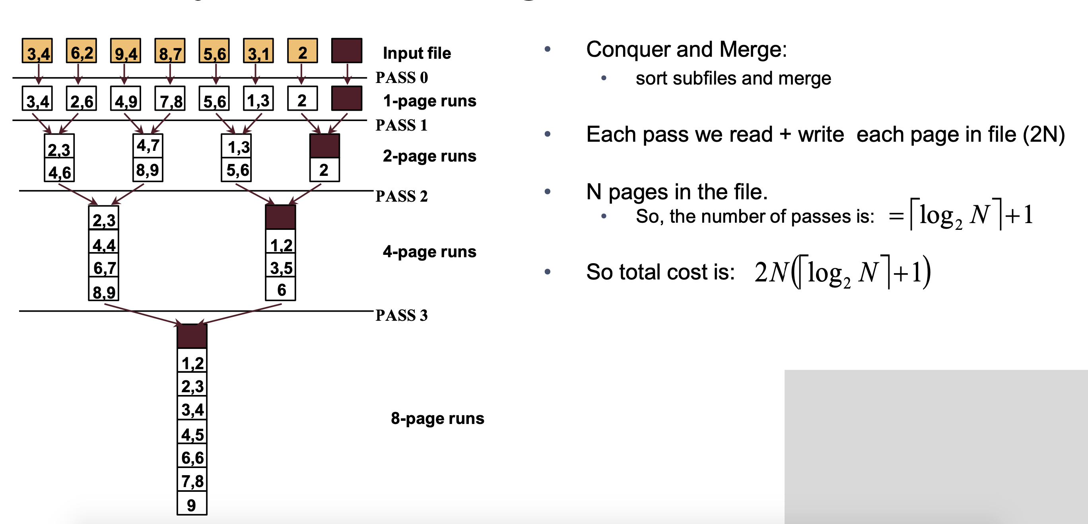
Two-Way External Merge Sort
分治的思想，归并排序

Slide 14
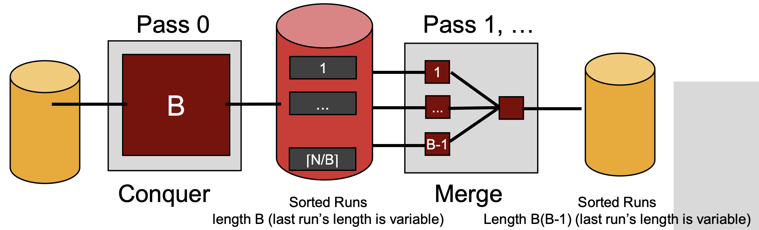
General External Merge Sort
To sort a file with N pages using B buffer pages
Pass 0: use B buffer pages. Produce |N/B| sorted runs of B pages each. 每次把B个pages里面的元素变得有序，一共有|N/B|个
input(B-1)
output(1)

Slide 15
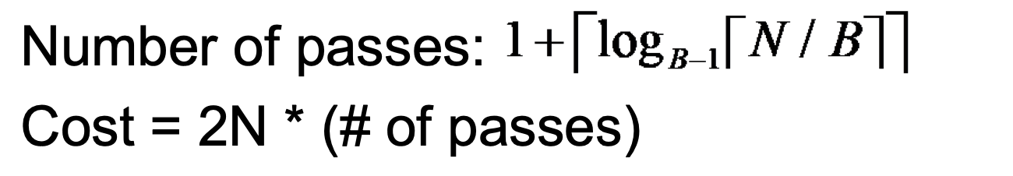
Cost of External Merge Sort

